Slide 1
Mortgage Statistics of the US

Slide 2
Problem Statement
Our objective is to conduct a comprehensive analysis of the NMDB® Aggregate Mortgage Statistics, delving into the interplay between mortgage metrics, demographics, and geographic variations, all while considering the impact of external macroeconomic factors like GDP, unemployment, and significant events like the COVID pandemic.
By combining univariate and multivariate studies with rigorous statistical tests and advanced machine learning techniques, we aim to offer actionable insights that can guide strategic planning and decision-making in the housing market, benefiting both industry stakeholders and potential clients.

Slide 3
Plan Of Action
Data Cleaning & Processing
Machine Learning Exploration
Data Analysis & Visualization
Hypothesis Testing & Experimentation

Slide 4
Current Progress
Data Pre-processing & Cleaning :
Processed dataset with 65 raw files.
Cleaned dataset of 37445 rows × 74 size to 37445 rows x 62 size by removing null values, binning, normalisation, etc.
Data Analysis :
Analysed data and visualised the dataset by plotting graphs, scatterplots and bar plots.
Hypothesis Testing
Created 10 hypothesis test ideas in coherence with our problem statement & tested 2 tests to verify our hypothesis. Employed techniques like z-test, ANOVA, t-test, etc to reject/accept each hypothesis.
Experiments
Conducted experiments on the complete dataset to evaluate the correctness of the hypothesis tests performed on the dataset.

Slide 5
Challenges with Raw Data
The raw data has several missing values which needed to be dropped or replaced.
Several columns had values dependent on other columns so they could not be replaced without taking into account the other dependent columns.
Noise and outliers in the dataset were removed to clean the dataset so that it can be processed for data analysis.
Handling the categorical variables.
Reducing the data values to a standard range.

Slide 6
Approach & Solutions
Fixing Null Values :
The null values in this case were fixed in two ways :
1. Replacing the null values with the mean of the column.
2. In some cases a few columns were interdependent. For example,
the columns PCT_BLACK and PCT_WHITE should sum upto 100.
So, in order to replace those values we calculated the mean of
each column and replaced the missing value with the ratio of
(current mean/sum of means) * 100.
Label Encoding to handle Categorical Values
Z-Score Normalisation to reduce the values to a smaller range.

Slide 7
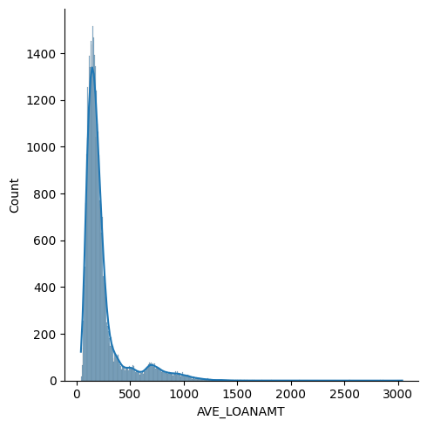
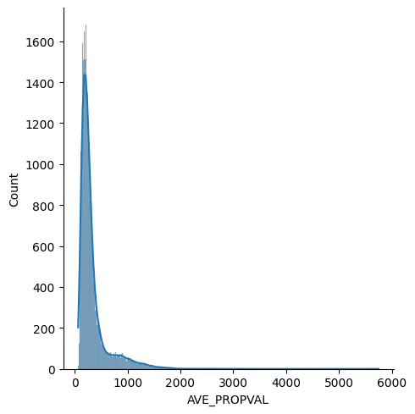
Hypothesis - 1
T-correlation test between Loan Amount & Average Property Value
H(0) ⇒ There is no correlation between the two variables
H(1) ⇒ There is correlation between the two variables
Hypothesis Test Result :
Correlation Value: 0.9795359301202943, Alpha: 0.0
T = 287.84094637927336, DOF = 3498
0.0 < 0.05: NULL hypothesis REJECTED in testing phase
Hypothesis Test Validation on the Dataset :
Correlation Value: 0.9770737986403297, Alpha: 0.0
T = 888.0454526278678, DOF = 37443
0.0 < 0.05: NULL hypothesis REJECTED in validation phase
Notes:
This is Total Loans given vs Interest Rate?

Slide 8
Hypothesis - 2
T-correlation test between No of Origins & Average Interest Rate
H(0) ⇒ There is no correlation between the two variables
H(1) ⇒ There is correlation between the two variables
Hypothesis Test Result :
Correlation Value: 0.017871487831611743, Alpha: 0.29051239936620227
T = 1.0571581884984413, DOF = 3498
0.29051239936620227 >= 0.05: NULL hypothesis ACCEPTED in testing phase
Hypothesis Test Validation on the Dataset :
Correlation Value: 0.027364049475720357, Alpha: 1.183973808640816e-07
T = 5.296980141841564, DOF = 37443
1.183973808640816e-07 < 0.05: NULL hypothesis REJECTED in validation phase

Slide 9
Inference
Testing for a small sample space :
This t-test result indicates that the number of origins & average interest rate are not directly correlated to each other and loan value vs average property value are directly correlated.
Testing for the dataset :
This t-test result indicates that the number of origins & average interest rate are directly correlated to each other.

Slide 10
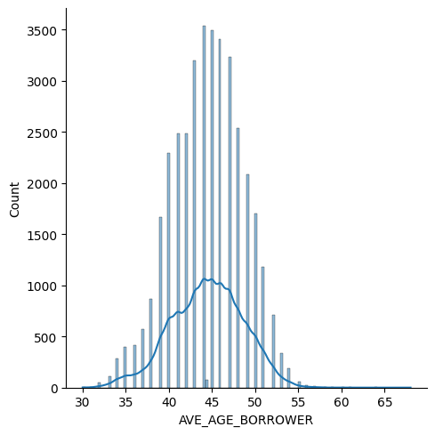
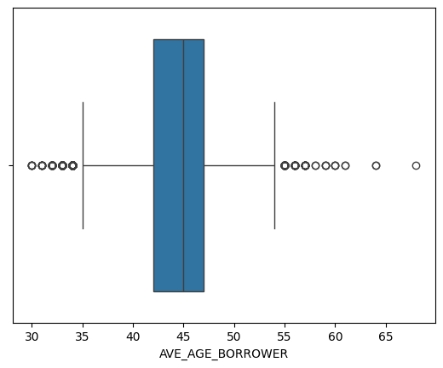
Hypothesis - 3
T test for testing AVG_AGE.
There is no significant difference between the sample mean and a hypothesized population mean.
H(0) ⇒ Over the years, average age of borrowers is 43
H(1) ⇒ Over the years, average age of borrowers is not 43
Hypothesis Test Result :
T Value: 19.4232473984624, Alpha: 6.850787325812924e-80
6.850787325812924e-80 < 0.05: NULL hypothesis REJECTED in testing phase
Hypothesis Test Validation on the Dataset :
T Value: 67.87150582237888, Alpha: 0.0
0.0 < 0.05: NULL hypothesis REJECTED in validation phase
Comparing sample distribution with the population mean
Sample_Mean = 44.355946483998714 POP_MEAN = 44.45317349887617
T Value: -1.392727800148613, Alpha: 0.1637906047621321
0.1637906047621321 >= 0.05: NULL hypothesis ACCEPTED in sample vs pop phase

Slide 11
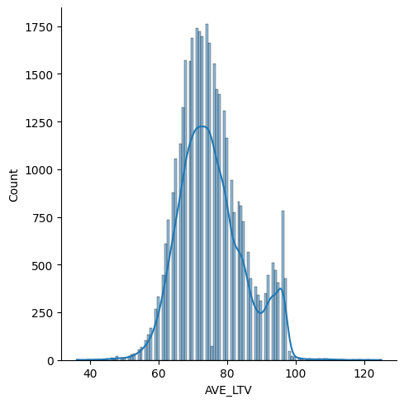
Hypothesis - 4a
T test for testing AVG_LTV.
There is no significant difference between the sample mean and a hypothesized population mean.
H(0) ⇒ Over the years, average Loan To Value is 75.
H(1) ⇒ Over the years, average Loan To Value is not 75
Hypothesis Test Result :
T Value: 1.6855948615908338, Alpha: 0.09196302323982113
0.09196302323982113 >= 0.05: NULL hypothesis ACCEPTED in testing phase
Hypothesis Test Validation on the Dataset :
T Value: 7.629662690193031, Alpha: 2.4093454201861012e-14
2.4093454201861012e-14 < 0.05: NULL hypothesis REJECTED in validation phase
75.26950208712405 75.37621748902923
Comparing sample distribution with the population mean
T Value: -0.6674491282183207, Alpha: 0.5045293098464224
0.5045293098464224 >= 0.05: NULL hypothesis ACCEPTED in sample vs pop phase

Slide 12
Hypothesis - 4b
T test for testing AVG_LTV.
There is no significant difference between the sample mean and a hypothesized population mean.
H(0) ⇒ Over the years, average LTV is 75
H(1) ⇒ Over the years, average LTV is not 75
Hypothesis Test Result :
T Value: -88.34745297805568, Alpha: 0.0
0.0 < 0.05: NULL hypothesis REJECTED in testing phase
Hypothesis Test Validation on the Dataset :
T Value: -296.569221439842, Alpha: 0.0
0.0 < 0.05: NULL hypothesis REJECTED in validation phase
Comparing sample distribution with the population mean
75.7923592299812 75.37621748902923
T Value: 2.5876965420284823, Alpha: 0.009701948549316173
0.009701948549316173 < 0.05: NULL hypothesis REJECTED in sample vs pop phase

Slide 13
THANK YOU!

